Slide 1
STUDENT Presentation

Slide 2
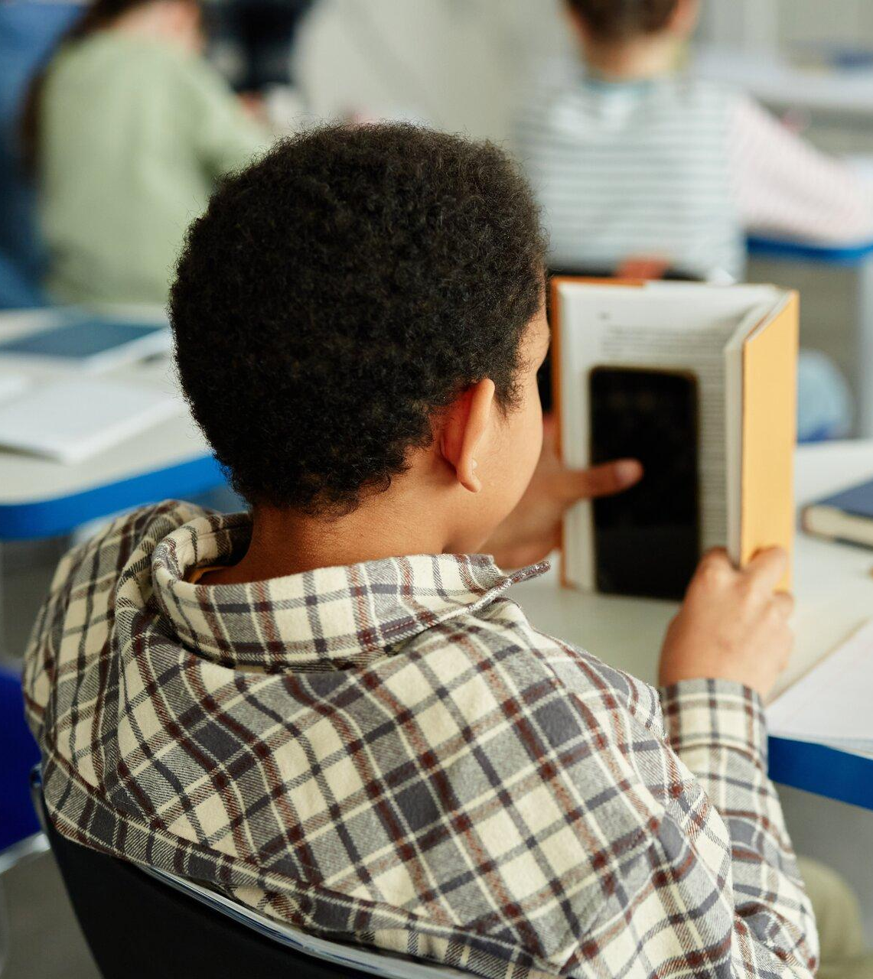
OUR PHONE-FREE SCHOOL
In September, our school will be using Yondr pouches to make our site phone-free.
Every student will be assigned a personal Yondr pouch and required to use it whilst at school. The Yondr pouch is considered school property, but it is your responsibility to bring your pouch with you to school every day and keep it in good working condition.

Slide 3
1 - why are we going phone-free?
2 - Why do we spend so much time on our phones?
3 - What is yondr?
4 - how will it work?
5 - FAQs
today, we are discussing…

Slide 4
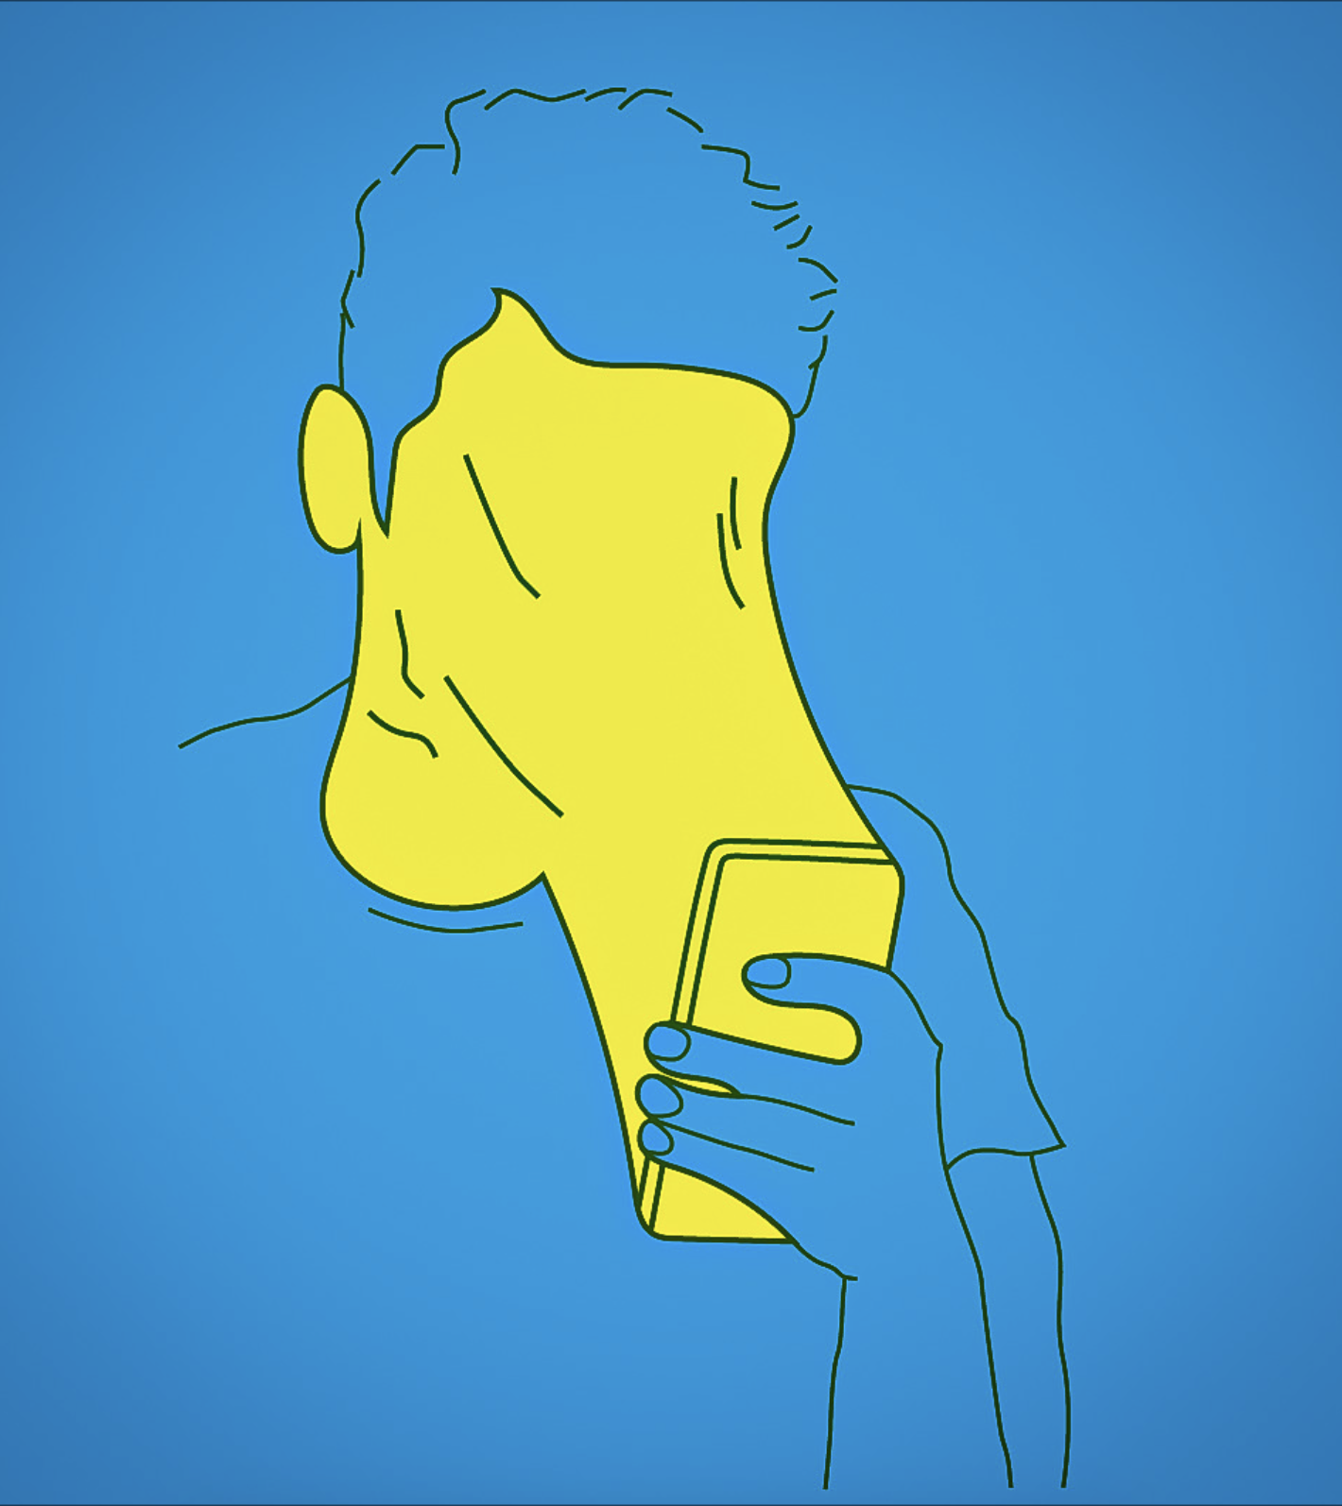
how many hours does a teenager spend on their phone each day?
7+ hours
Notes:
Pose question to the students. Hands up if you think teenagers spend more than 5 hours a day on their phones?
Source: https://abcnews.go.com/US/teens-spend-hours-screens-entertainment-day-report/story?id=66607555#:~:text=Teens%20spend%20an%20average%20of,technology%20and%20media%20for%20children.

Slide 5
How many years of your life will you spend on your phone?
22 years

Slide 6
why does social media want our attention?
YONDR — PRIVATE + CONFIDENTIAL
Notes:
Teacher to explain that answer of course is Money! Social media companies make money from advertisers based on how much time people are spending on their apps. The more eyeballs they can say they have on their app, the more money advertisers will pay to reach those audiences. Why do you think Snapchat created “Snap Streaks”?​
​

Slide 7
Endless Scrolling: Instagram + TikTok
Up Next: Netflix
Autoplay: Youtube
Streaks: Snapchat
how do they keep our attention?
Notes:
Hands up - who has gone onto their phone for a quick browse and then before you know it you’ve spent over 2 hours scrolling through TikToks?
These apps are designed to keep our attention on their sites.

Slide 8
the impact of phones in the classroom
3 hours
20 minutes
The time it takes for students to regain focus after a nearby phone distraction.
*US Surgeon General (2024)

Slide 9
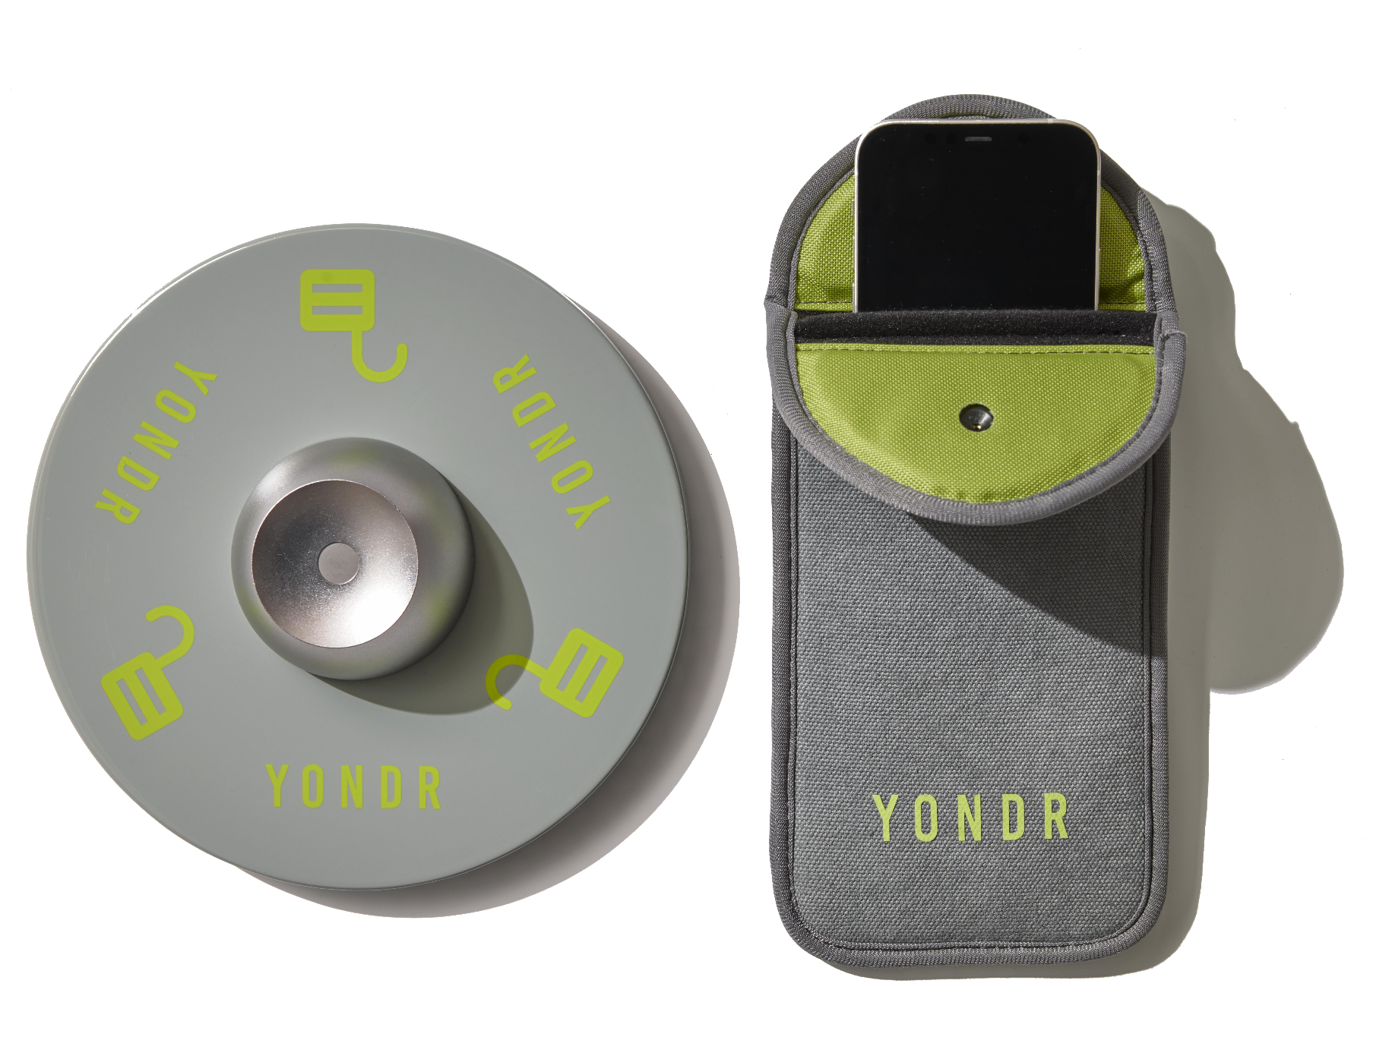
THE YONDR Solution
The Yondr pouch allows students to experience the focus, creativity, and relief that comes from a phone-free school day.

Slide 10
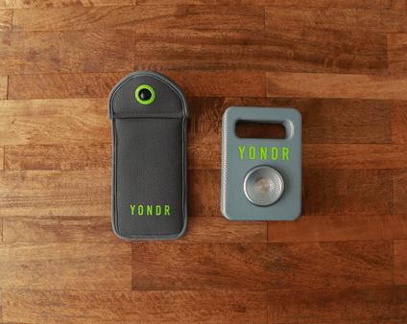
ARRIVAL DEMONSTRATION
Open your Yondr pouch at an unlocking station.
Turn phone off or onto airplane mode.
Slide phone and smartwatches into pouch.
Close the top of the pouch.
Press the green push-pin button to secure.
Show closed pouch to a member of staff and then place in your bag.
Notes:
Edit the slide as necessary to make it relevant to your school pouching process.
As students arrive at school, they will turn their phones off or place them into airplane mode. Other accessories such as smartwatches and airpods also need to be turned off.
These devices and accessories will then be placed in a Yondr pouch and locked.
Phones will then be placed inside their backpacks and secured.
The phone policy will be enforced from arrival to dismissal each day. Students will maintain possession of their phones and will not use them until their pouches are opened at the end of the school day at an unlocking station.

Slide 11
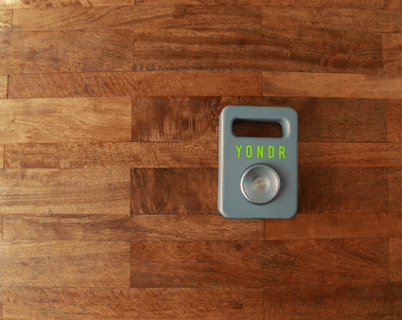
END OF DAY DEMONSTRATION
Tap the side with the green circular ring to the unlocking base.
As you tap the pouch on the base,
push the button to release the lock.
Retrieve your phone and close the pouch back up.
Take your pouch with you for the following school day.
Notes:
Edit the slide as necessary to make it relevant to your school pouching process.
When leaving school, students will use a Yondr base to unlock their pouch and retrieve their phone
The pouch MUST be closed up again and locked before heading home to avoid any pouch damage.

Slide 12
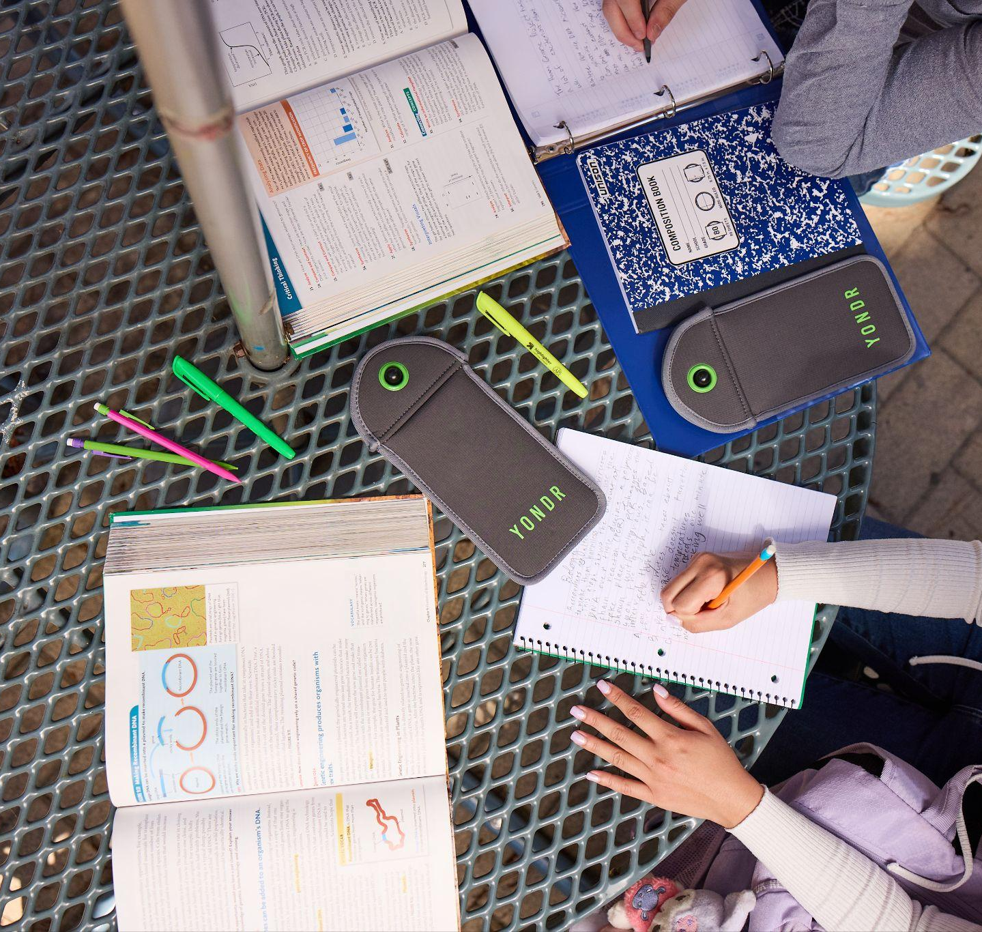
student pouch guidelines
Pouches are going to be checked on a regular basis during school time.
The pouches are each student’s responsibility at all times.
A reminder that all smart watches are banned
Do not pull, pry or tamper with the pouches in any way. Banging or trying to destroying your pouch has resulted in a broken phones.

Slide 13
Special Circumstances for Mobile Phone Use
Students with certain medical conditions
For students with certain medical conditions e.g. Type 1 Diabetes will have a velcro Yondr pouch that they can open at any time or they can choose to not purchase a pouch.
Subjects that require mobile phone use:
There are certain subjects in which students may need to use their mobile phones (e.g. - Art). These departments will have portable magnets available.
Students on fixtures will unlock as they depart at the main office or with the PE staff.

Slide 14
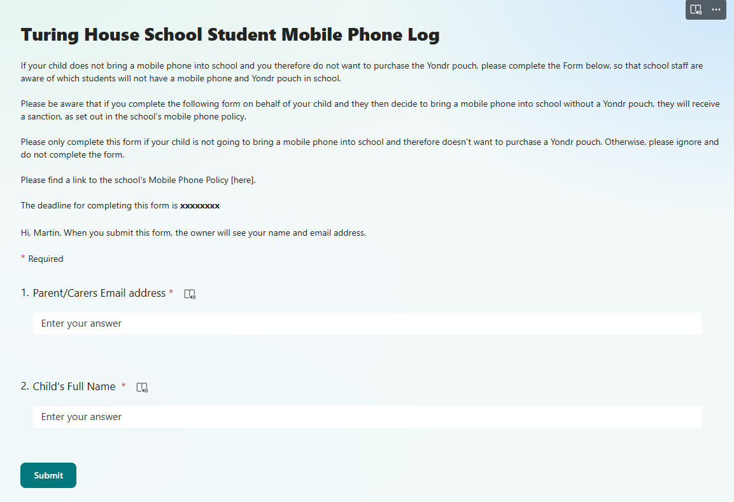
Logistics
Your parents will complete a form if you are NOT bringing a mobile phone into school
If a student has brought their mobile phone into Period 1 and has either forgotten their Yondr pouch or has a damaged Yondr pouch that won't lock, teachers will send them to the main office in order to drop their mobile phone into the digital detox box. Students who are late to school will do the same.
detox box. Tutors must also email Student Services to inform them that the student is on their way.

Slide 15
Unlocking device location

Slide 16
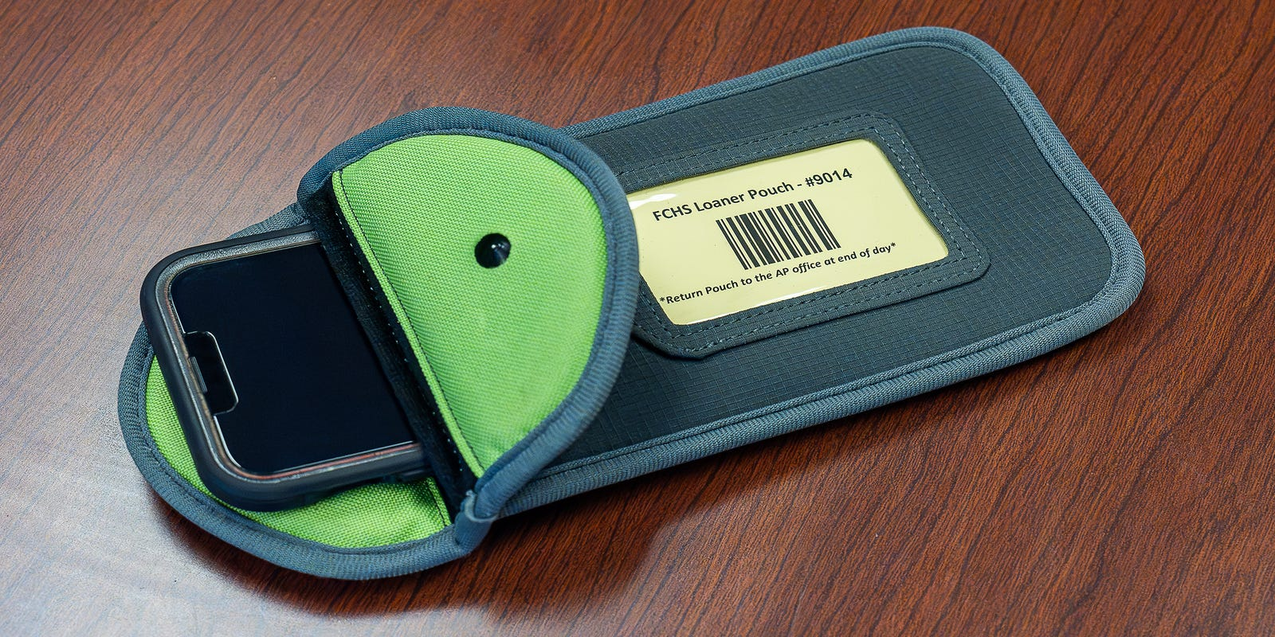
Labelling Yondr Pouches
When students first receive their Yondr pouches, they will also be given a card by their tutor that will have their name, form and school contact details on.
This card slots into the plastic sleeve on the Yondr pouch. If a student loses their card/Yondr pouch, they can collect a new card from the main office.

Slide 17
Yondr Yoga & Spot Checks
Yondr Yoga
Hold up the phone in one hand and the pouch in the other
Tap the screen to make sure it is off
Lock it
Pinch the pouch in the corner, hold the pouch upside down and shake it
Bag searches and Phone Wands
Spot checks will happen regularly, throughout the school day
Spot checks will focus on the legitimacy of the phone and any damage to the pouch
Spot checks will also be done with members of SLT who will use a phone wand and complete bag searches
Students found with phones will be sanctioned

Slide 18
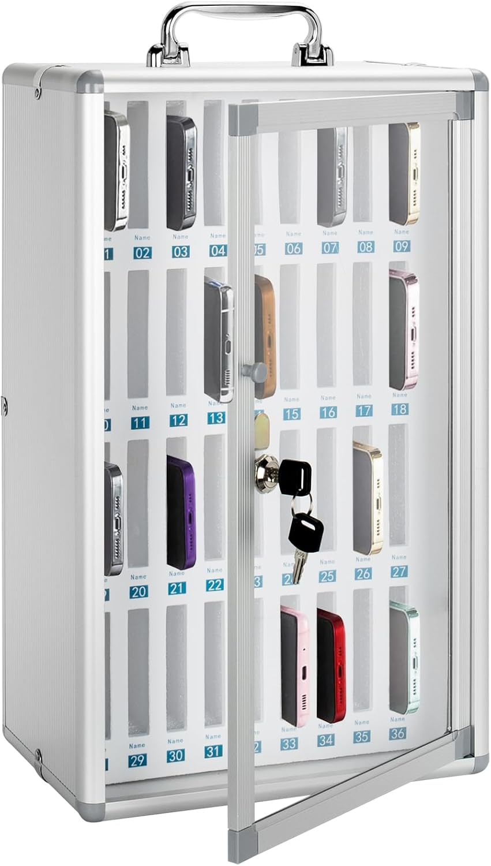
Procedures for Forgotten or Damaged Pouches
1. Student forgets Yondr pouch
Period 1 teacher sends them to the Main Office to drop their phone into the Digital Detox Box and can collect it at 3pm.
2. Student has damaged pouch that won't lock
Teacher sends them to the Main Office to drop their phone into the Digital Detox Box and can collect it at 3pm.
3. Student doesn't normally bring a phone but has one today
Teacher sends them to the Main Office to drop their phone into the Digital Detox Box and can collect it at 3pm.
4. Student needs a new Yondr Pouch
Students can purchase this via ParentPay and collect it from the main office once the tutor has been notified. Tutors must ensure that tutees give their mobile phone into the Main Office every day until their new Yondr pouch arrives.

Slide 19
Procedures for Forgotten or Damaged Pouches
Scenario | Details | Action Taken
Pouch damaged/lost pouch | Examples of damage: Ripped fabric · Torn / cut · Bent pin · Signs of force to black button or flap · Damage to the black ball · Pouch opens without unlocking station | New pouch will need to be purchased via ParentPay. Place mobile phone into the Digital Detox Box in Student Services until a new Yondr pouch is purchased. If malicious and/or repeated, may result in a 60-minute detention, internal exclusion or suspension.
Forgotten pouch |  | Place mobile phone into the Digital Detox Box in the Main Office for the day & to be collected at the end of the day.
Accidental damage |  | Place mobile phone into the Digital Detox Box in the Main Office until a new Yondr pouch has been purchased and issued.
Phone is seen during the school day/not in Yondr pouch |  | 1st time: Phone confiscated and returned at 4pm. Two-hour pastoral detention after school; parents informed. 2nd time: Phone confiscated, returned at 4pm, student internally excluded; parents informed. 3rd time: Off Site Placement / Suspension and Parental Meeting.
In possession of an Unlocking Station (magnet) |  | Suspension

Slide 20
Confiscation Procedures
Procedure | Details
Phone seen | If a student is seen with a mobile phone between 8.30am–3pm, it will be confiscated by the member of staff.
Student refusal | If a student refuses to hand their phone in, then staff will escalate this to On Call as soon as possible. This will result in an immediate on call and internal inclusion.
Phone handover | If a member of staff has to confiscate a student’s phone, it will be handed in to the Main Office, where it will be placed in the Digital Detox Box.
Family notification | The Main Office will send a letter to the parents/carers informing them of the confiscation and which “tier” the student is currently on for confiscation.
Phone ringing in lesson | If a student’s mobile phone rings or goes off in a lesson, the student should be sent to the Main Office to unlock their Yondr pouch, switch the phone off, and lock it back in.
Sixth Form Students with Phones | If Sixth Formers (who do not have Yondr pouches) are seen with their phone outside of Sixth Form areas, it will be confiscated and handed into the main office to be placed in the digital detox box.

Slide 21
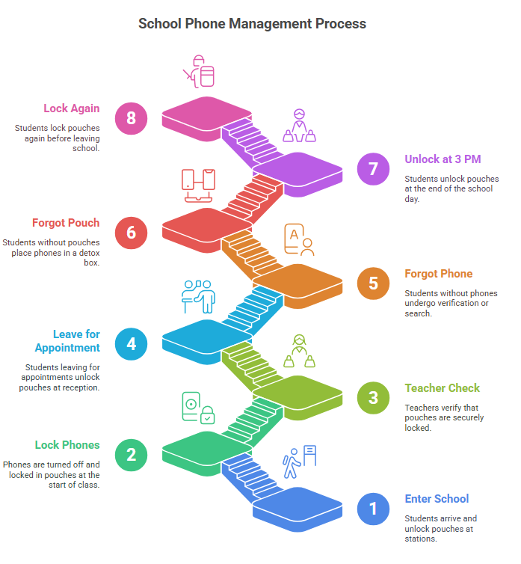
Students enter the school site and unlock their pouch at one of the unlocking stations.
At the start of lesson one, students will turn off their phone and place the phone in the pouch and lock it
The class teacher will check that this is locked.
A student leaving the school site for an appointment or fixture will go to the student reception to get their pouch unlocked
A student who says they have left their phone at home will go to student reception. A call will be made to confirm that the phone is at home. In the event that this cannot be confirmed, a bag search/use of phone wand will occur.
A student forgetting their pouch will go to student reception and their phone will be placed in the phone detox box. Students will collect this at the end of the day.
At 3pm all students will unlock their pouches and access their phone
Students should then lock their pouch

Slide 22
Frequently asked questions

Slide 23
PROCEDURES
What if i’m running late or need to leave school early?
Unlocking stations will be placed at school reception and checked by staff for late arrivals or early dismissal.
What happens if i forget it at home?
Your phone will be collected in and returned at dismissal. If this happens on multiple occasions there will be additional consequences.
Notes:
Edit the slide as necessary to make it relevant to your phone policy procedures.

Slide 24
PROCEDURES
Students will have to pay for a replacement pouch. Your phone will need to be stored in the office each day until the fee is paid for a new one.
Report any accidental damage immediately to a teacher.
To avoid accidental damage ensure to close your Yondr pouch at the end of the day after retrieving your phone.
Place the pouch on top of your books or in a separate compartment of your backpack.
What happens if a student accidentally damages their yondr pouch?
Notes:
Edit the slide as necessary to make it relevant to your phone policy procedures.

Slide 25
PROCEDURES
What happens if a student is seen with a phone outside of a yondr pouch?
The phone will be confiscated immediately and the student issued a detention. Your phone will be returned once a parent picks it up.
Notes:
Edit the slide as necessary to make it relevant to your phone policy procedures.

Slide 26
ONLINE ‘hacks’
There are videos online spreading misinformation on gaining access to a locked Yondr pouch. These ‘hacks’ are not applicable to new Yondr pouches and are a direct violation of school policy.
Smashing the black ball/unlocking button against a brick wall or hard surface.
Consequence:
Students who have attempted this ‘hack’ have ended up with cracked screens and/or broken phones.
Placing two pens/pencils down the side of the pouch and pushing upwards to open the pouch.
Consequence:
Broken pencils and pens. This doesn’t work and leaves permanent pen and pencil marks on the inside of the pouch.
Purchasing a magnet to open the pouch.
Consequence:
Wasting Money. Many magnets do not have the same strength as Yondr unlocking stations. If you bring a magnet to school there will be disciplinary action.
If a student is caught attempting to break into their pouch or you are found with a magnet, the phone will be confiscated immediately and there will be disciplinary action. The Yondr system is being implemented to create a distraction-free environment that benefits everybody.
Notes:
Reinforce the ‘WHY’ – To create an engaging learning environment for all students. The yondr pouches are there to benefit students not to punish them.

Slide 27
yondr student testimonials
It will be good to put my phone aside and not be distracted at all.
— Charlotte, Student, Victoria College
You can really tell the difference now. I’m concentrating way more in school and my grades have gone up. Lunchtime is a lot better, because you’re talking to your friends more, instead of just going on your phone. There’s no social media impacting things, and most of the drama comes from social media. Now there’s not much drama, but there’s still lots to talk about.
It didn’t even take me a week to get used to it, it’s so much better. At lunchtime now we all talk to each other, and no one is on their phone
YONDR SURVEY RESULTS
— Lara Daris, Student,
St Raphaela's Secondary School
Saw a positive change in student engagement
Saw a positive change in student behavior
— Student, Pobalscoil Chorca Dhuibhne, Ireland
Notes:
End by emphasising that the aim of the programme is to support concentration, academic progress and have a break in the day from phones. Read aloud some of the student testimonials from other schools that have implemented Yondr.

Slide 28
THANK YOU
We look forward to seeing the positive impact of our phone-free school!
Learn more
www.overyondr.com

