Slide 1
Yondr at Turing House School
Parent/Carer Presentation
9th June 2025
.

Slide 2
Aims
At THS we recognise that mobile phones are an important part of everyday life for our pupils and families, as well as the wider school community. Our policy aims to:
Promote safe and responsible phone use
Set clear guidelines for the use of mobile phones for pupils, staff, families, visitors and volunteers
Support the school’s other policies; in particular the school’s Safeguarding, Behaviour and Anti-Bullying policies
It is important to recognise the latest government guidance Mobile phones in schools - February 2024 and to support initiatives such as Smartphone Free Childhood Parent Pact

Slide 3
Rationale
This change also aims to address some of the challenges posed by mobile phones in schools, such as:
Risks to child protection
Bullying
Potential for lesson disruption
Risk of theft, loss or damage
Appropriate use of technology in the classroom
Data protection issues
Addiction

Slide 4
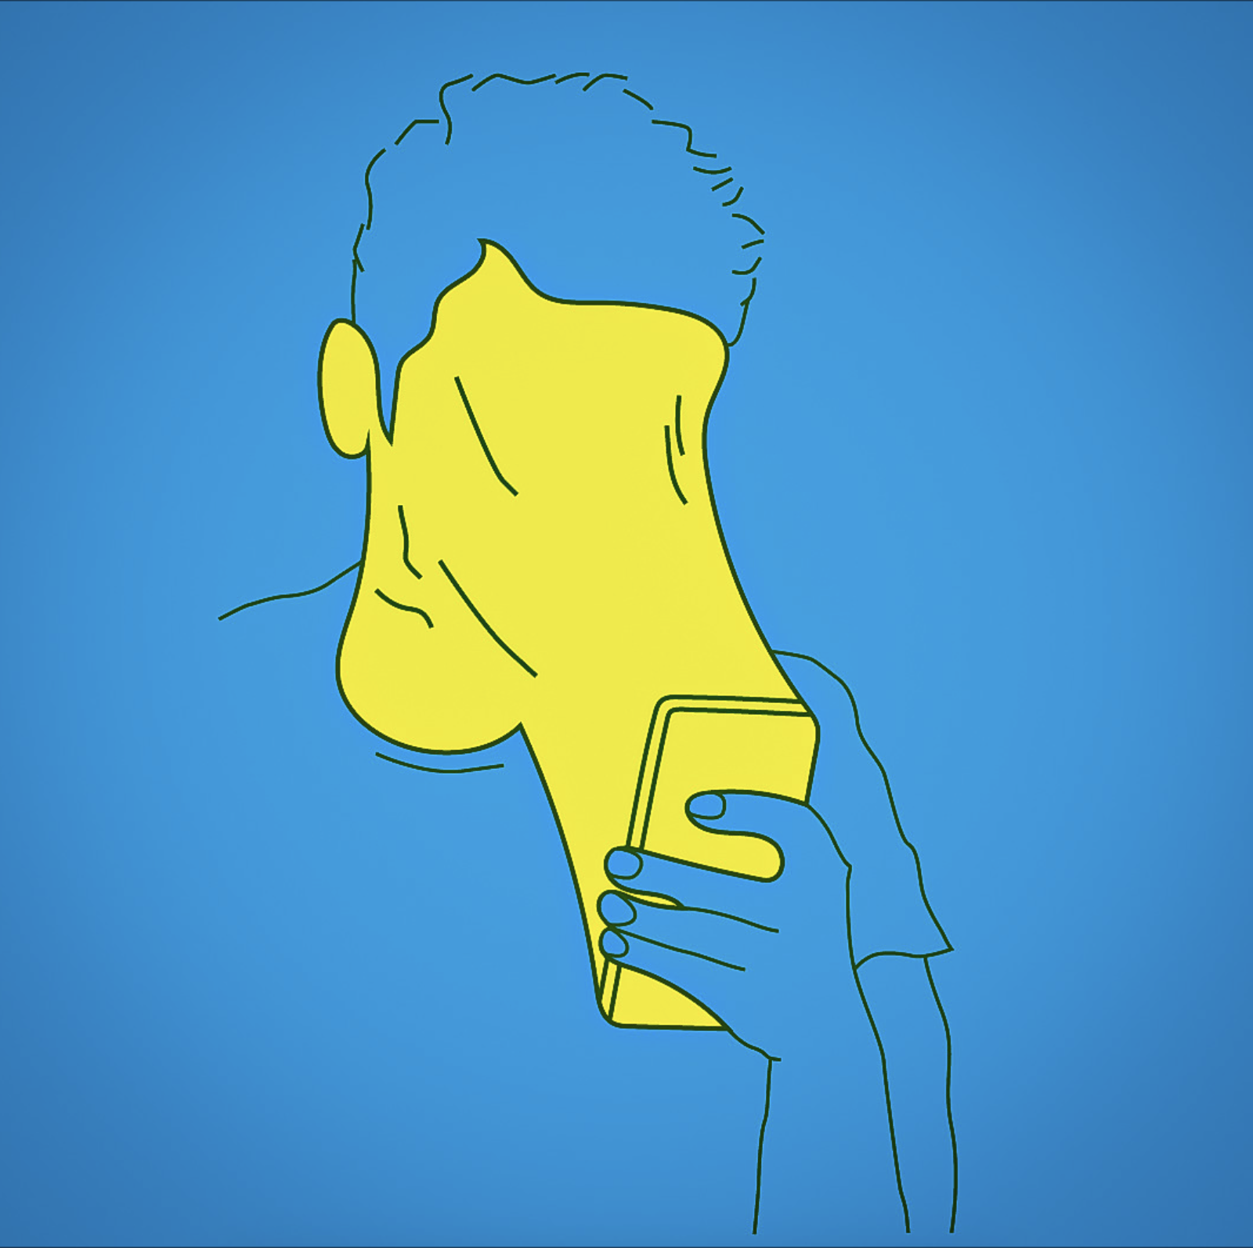
Rationale
The average person will spend on their mobile phone.
The average teenager spends each day on their phone
22 years
7+ hours

Slide 5
Mobile Phones at Turing House School
Turing House will be a mobile phone free school from September 2025. All students who bring a mobile phone into school must have a Yondr pouch and bring it into school every day.
8:30am – 3:00pm Students will keep their phones locked in their Yondr pouch.
At 3:00pm Students can open their Yondr pouch via one of the 10 magnets positioned around the school and use their phones again.
For students who do not bring a mobile phone into school, their parent/carer must have informed the school via a Microsoft Teams Form.
The school also recognises that some of our students rely on their mobile phones as an essential, potentially lifesaving medical device. Therefore, students with medical conditions, such as diabetes, will have a velcro Yondr pouch.
If a student's mobile phone is seen between the hours of 8.30am-3pm and not in a Yondr pouch, the phone will be confiscated.

Slide 6
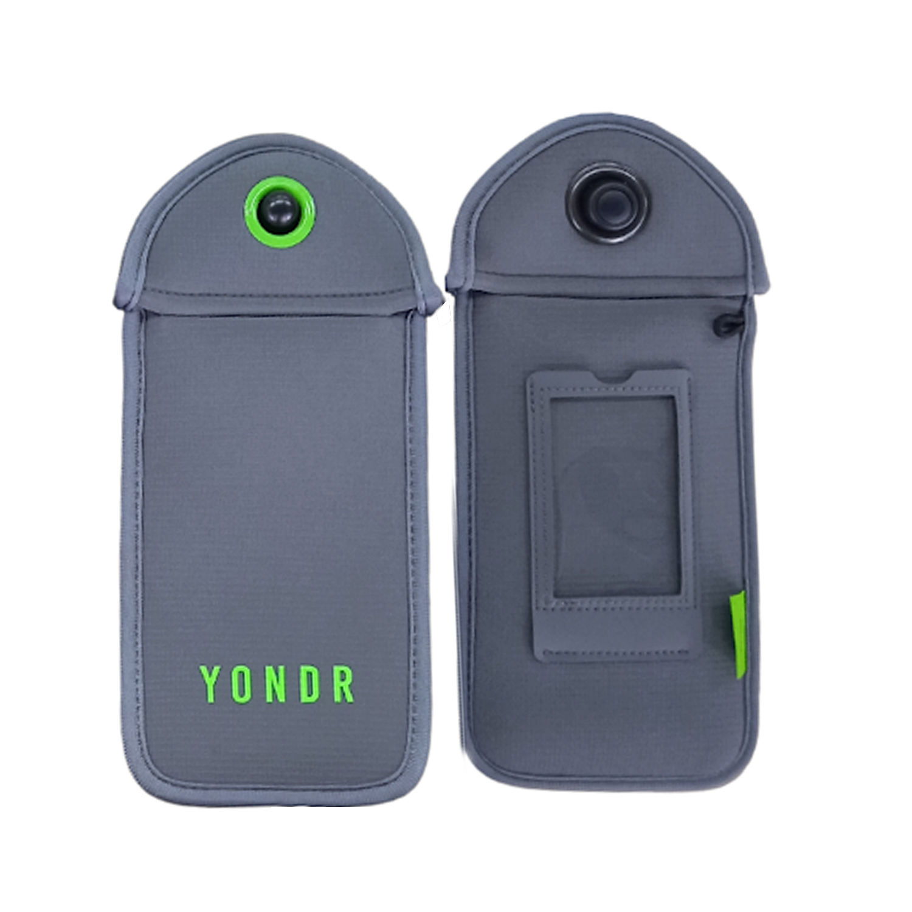
What is a Yondr Pouch
A Yondr pouch is a secure, lockable bag designed to create phone-free spaces. When you enter a designated phone-free area, your phone is placed inside the Yondr pouch, which is then locked. You keep the pouch with you, but you can't access your phone until you leave the phone-free zone and unlock the pouch at a designated station.
Pouches are used at concerts, schools, and other events to minimise distractions and encourage engagement.

Slide 7
Special Circumstances for Mobile Phone Use
Students with certain medical conditions
For students with certain medical conditions, smartphones can act as a lifesaving, essential medical device, including those with Type 1 Diabetes. These students will have a velcro Yondr pouch that they can open at any time or they can choose to not purchase a pouch. Staff can find out whether a student has a medical pouch etc. (or no phone) by accessing the relevant Mobile Phone Spreadsheet.
Subjects that require mobile phone use:
There are certain subjects in which students may need to use their mobile phones (e.g. - Art). These departments will have portable magnets available. Students on fixtures will unlock as they depart at the main office or with the PE staff.
It is important that if students do unlock their Yondr pouches to use their mobile phones for work in a lesson, that the member of staff ensures that all students at the end of the lesson switch off their mobile phone and lock it back in their Yondr pouch.

Slide 8
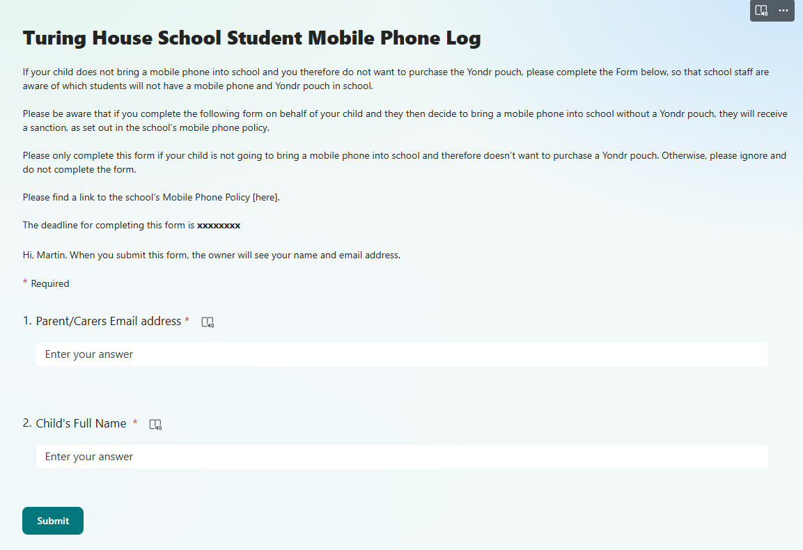
Logistics
This Microsoft Form should only be completed if your child is NOT bringing a mobile phone into school
If a student has brought their mobile phone into Period 1 and has either forgotten their Yondr pouch or has a damaged Yondr pouch that won't lock, teachers will send them to the main office in order to drop their mobile phone into the digital detox box. Students who are late to school will do the same.
detox box. Tutors must also email Student Services to inform them that the student is on their way.

Slide 9
Unlocking device location

Slide 10
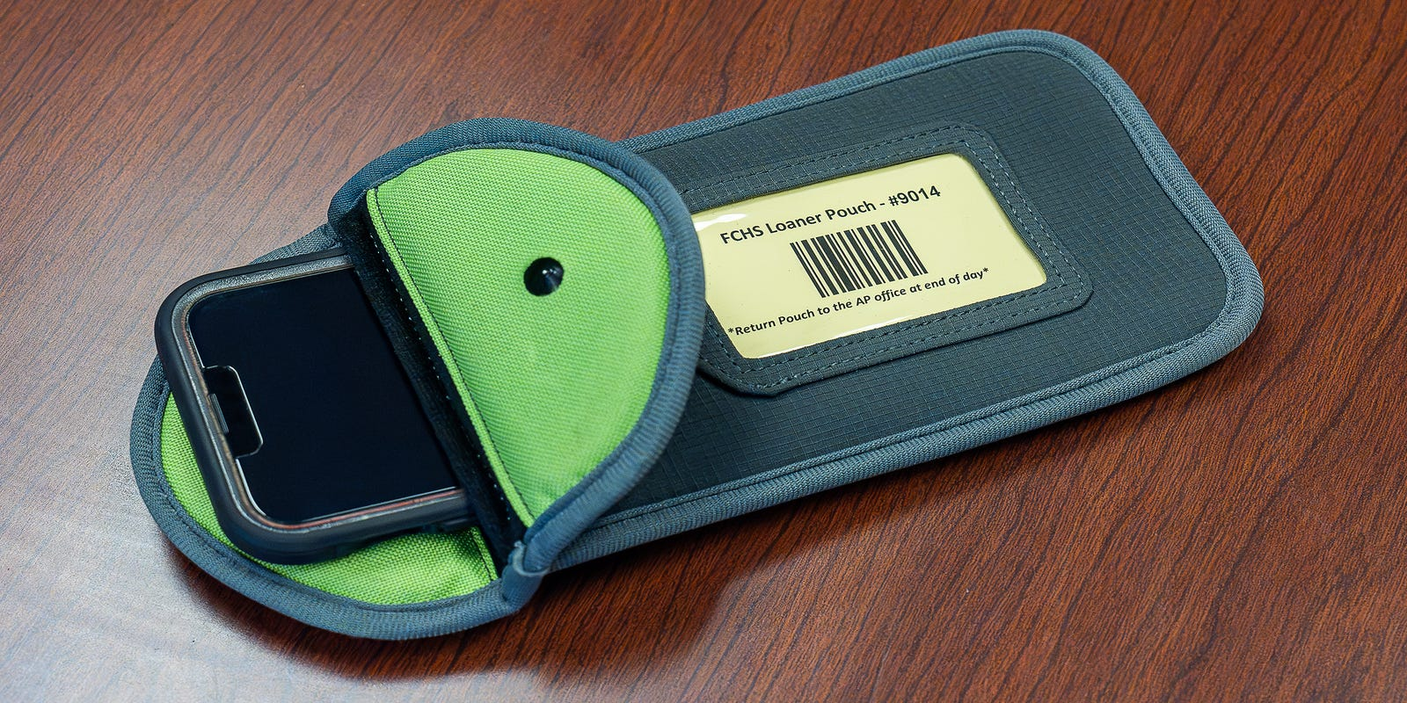
Labelling Yondr Pouches
When students first receive their Yondr pouches, they will also be given a card by their tutor that will have their name, form and school contact details on.
This card slots into the plastic sleeve on the Yondr pouch. If a student loses their card/Yondr pouch, they can collect a new card from the Main Office.

Slide 11
Yondr Yoga & Spot Checks
Yondr Yoga
Hold up the phone in one hand and the pouch in the other
Tap the screen to make sure it is off
Lock it
Pinch the pouch in the corner, hold the pouch upside down and shake it
Bag searches and Phone Wands
Spot checks will happen regularly, throughout the school day
Spot checks will focus on the legitimacy of the phone and any damage to the pouch
Spot checks will also be done with members of SLT who will use a Phone Wand to complete bag searches
Students found with phones will be sanctioned

Slide 12
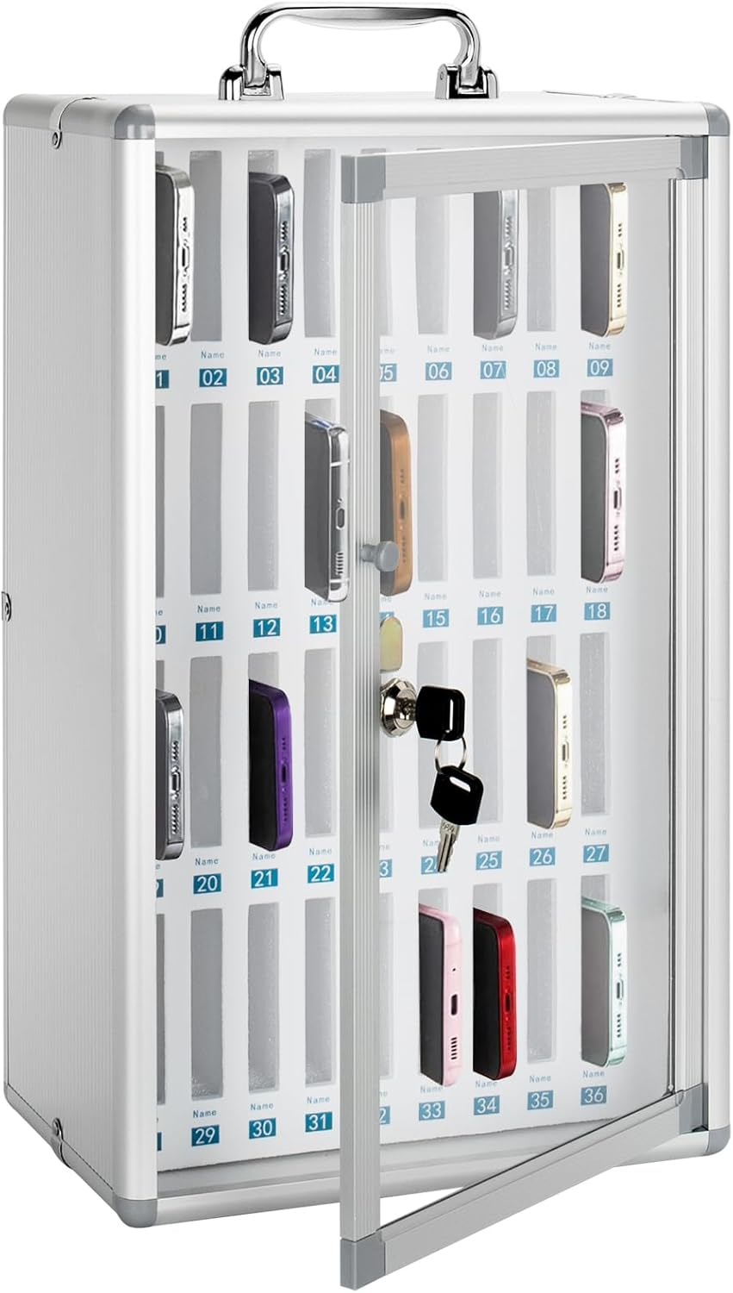
Procedures for Forgotten or Damaged Pouches
1. Student forgets Yondr pouch
Period 1 teacher sends them to the Main Office to drop their phone into the Digital Detox Box and can collect it at 3pm.
2. Student has damaged pouch that won't lock
Teacher sends them to the Main Office to drop their phone into the Digital Detox Box and can collect it at 3pm.
3. Student doesn't normally bring a phone but has one today
Teacher sends them to the Main Office to drop their phone into the Digital Detox Box and can collect it at 3pm.
4. Student needs a new Yondr Pouch
Students can purchase this via ParentPay and collect it from Student Services once the tutor has been notified. Tutors must ensure that tutees give their mobile phone into the Main Office every day until their new Yondr pouch arrives.

Slide 13
Procedures for Forgotten or Damaged Pouches
Scenario | Details | Action Taken
Pouch damaged/lost pouch | Examples of damage: Ripped fabric · Torn / cut · Bent pin · Signs of force to black button or flap · Damage to the black ball · Pouch opens without unlocking station | New pouch will need to be purchased via ParentPay. Place mobile phone into the Digital Detox Box in Student Services until a new Yondr pouch is purchased. If malicious and/or repeated, may result in a detention, internal exclusion or suspension.
Forgotten pouch |  | Place mobile phone into the Digital Detox Box in the Main Office for the day & to be collected at the end of the day.
Accidental damage |  | Place mobile phone into the Digital Detox Box in the Main Office until a new Yondr pouch has been purchased and issued.
Phone is seen during the school day/not in Yondr pouch |  | 1st time: Phone confiscated and returned at 4pm. Students will sit a detention after school; parents informed. 2nd time: Phone confiscated, returned at 4pm, student internally excluded; parents informed. 3rd time: Off Site Placement / Suspension and Parental Meeting.
In possession of an Unlocking Station (magnet) |  | Suspension

Slide 14
Confiscation Procedures
Procedure | Details
Phone seen | If a student is seen with a mobile phone between 8.30am–3pm, it will be confiscated by the member of staff.
Student refusal | If a student refuses to hand their phone in, then staff will escalate this to On Call as soon as possible. This will result in an immediate on call and internal inclusion.
Phone handover | If a member of staff has to confiscate a student’s phone, it will be handed in to the Main Office, where it will be placed in the Digital Detox Box.
Family notification | The Main Office will send a letter to the parents/carers informing them of the confiscation and which “tier” the student is currently on for confiscation.
Phone ringing in lesson | If a student’s mobile phone rings or goes off in a lesson, the student should be sent to the Main Office to unlock their Yondr pouch, switch the phone off, and lock it back in.
Sixth Form Students with Phones | If Sixth Formers (who do not have Yondr pouches) are seen with their phone outside of Sixth Form areas, it will be confiscated and handed into the main office to be placed in the digital detox box.

Slide 15
Your Questions Answered
​What if I need to contact my child?
What happens with sporting fixtures?​
What about if my child forgets to unlock their pouch and doesn’t realise until later in the day?​
What if my child needs to contact home?
I don’t agree with the change. What can I do? Mobile phones in schools - February 2024
What if my child has a detention?
What if I don’t want to pay for the pouch?

Slide 16
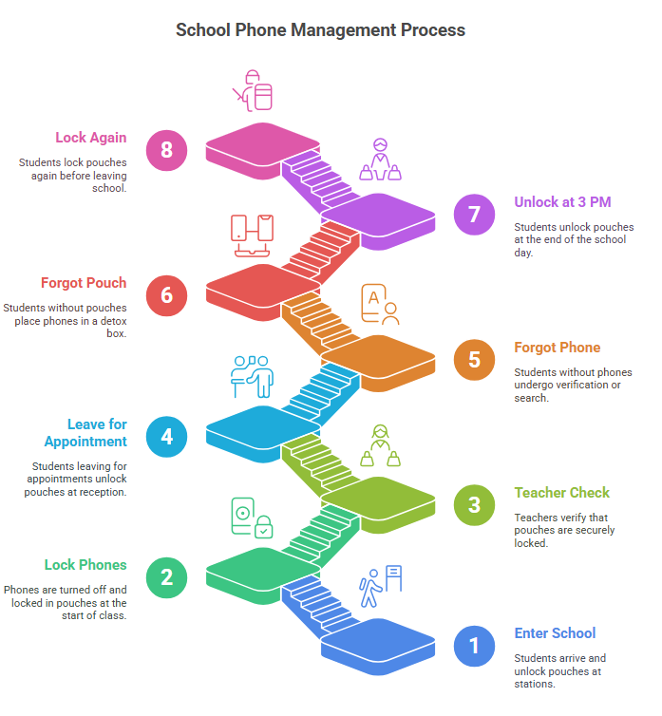
Students enter the school site and unlock their pouch at one of the unlocking stations.
At the start of lesson one, students will turn off their phone and place the phone in the pouch and lock it
The class teacher will check that this is locked.
A student leaving the school site for an appointment or fixture will go to the student reception to get their pouch unlocked
A student who says they have left their phone at home will go to student reception. A call will be made to confirm that the phone is at home. In the event that this cannot be confirmed, a bag search/use of phone wand will occur.
A student forgetting their pouch will go to student reception and their phone will be placed in the phone detox box. Students will collect this at the end of the day.
At 3pm all students will unlock their pouches and access their phone
Students should then lock their pouch

Slide 17
Thank you for your support.
Thank you all for supporting the implementation of Yondr at Turing House School.
The next step might be to consider how you can continue support with your child's phone use at home.
As a reminder, the legal age for the majority of social media apps (TikTok, Snapchat, Instagram, Whatsapp) is 13, and ultimately, you are the bill payer so you get to set the rules!
If you have any further questions about the mobile phone policy at Turing House School or Yondr, please contact your child’s Head of Year.
NEXT STEPS – Parent Pay will be set up for parents to purchase the pouches.

